Slide 1
Jukebox Java project
-Joinal Rodrigues

Slide 2
Features
Can play .wav and .mp3 files.
User account generation and authentication.
Hashed passwords stored for additional security.
User can search for and listen to any content based on multiple search criteria.
User can create multiple playlists of songs or podcasts.
Playlists can be shuffled or set on repeat or set to previous or next playlist item.
Time counter available to check remaining time of ongoing content(Only in Windows).

Slide 3
Libraries and classes used
Jaco mp3 player
AudioInputStream
Jdbc connector to mySql
Stream API
Thread
ProcessBuilder
Robot

Slide 4
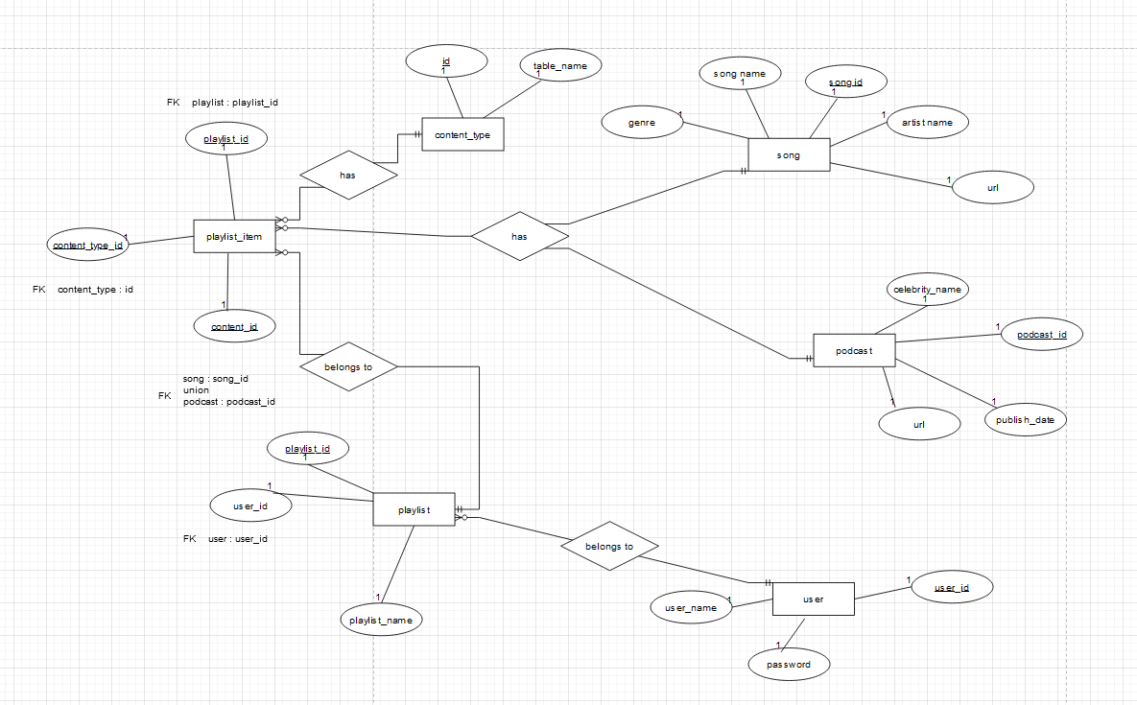
ER diagram

Slide 5
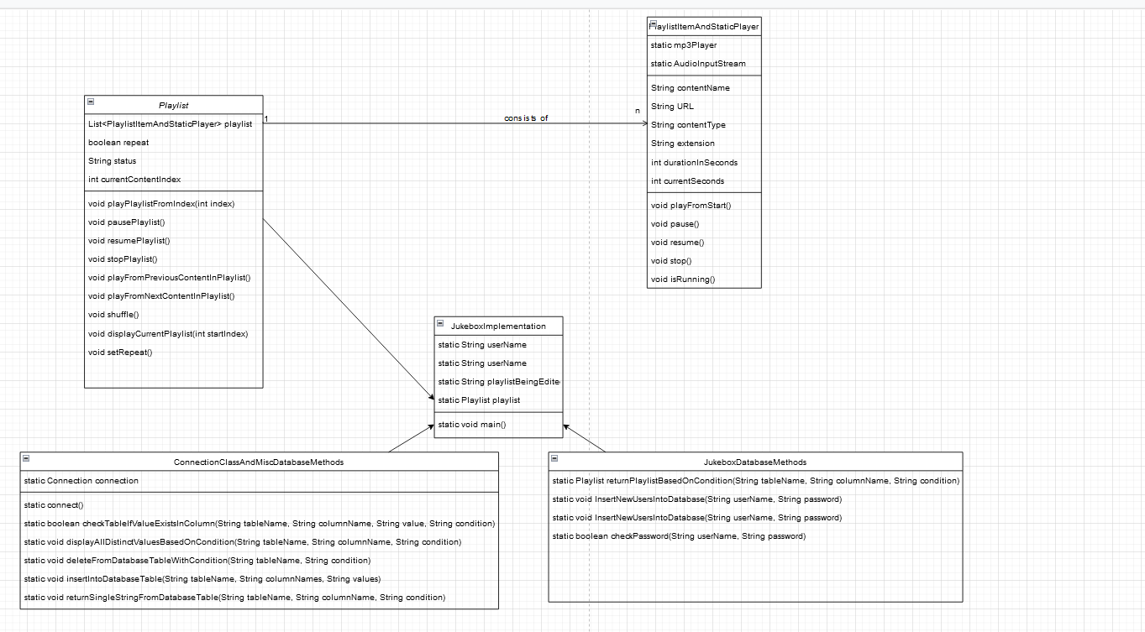
Class diagram

Slide 6
Thank you

